Slide 1


Acme AeroTech
Acme AeroTech
Secure network redesign
Name: Eddy Max Kilonzo

Slide 2

Agenda
01
Scenario & critical assets
02
Current network and its weaknesses
03
Vulnerability analysis & risk prioritization
04
Proposed secure redesign + security controls
05
Trade-offs and key takeaways

Slide 3
Scenario Summary

Slide 4


Scenario Summary
Organization
mid-sized aerospace engineering firm
Critical Challenges
hybrid workforce
flat network
ITAR-adjacent work
no segmentation
weak public-facing protections
Objectives
no monitoring
protect engineering IP
single points of failure
keep design/finance/HR available
default IoT credentials
support secure remote work
unencrypted FTP
meet ITAR/contract obligations
no MFA

Slide 5
Current Network Diagram Overview

Slide 6

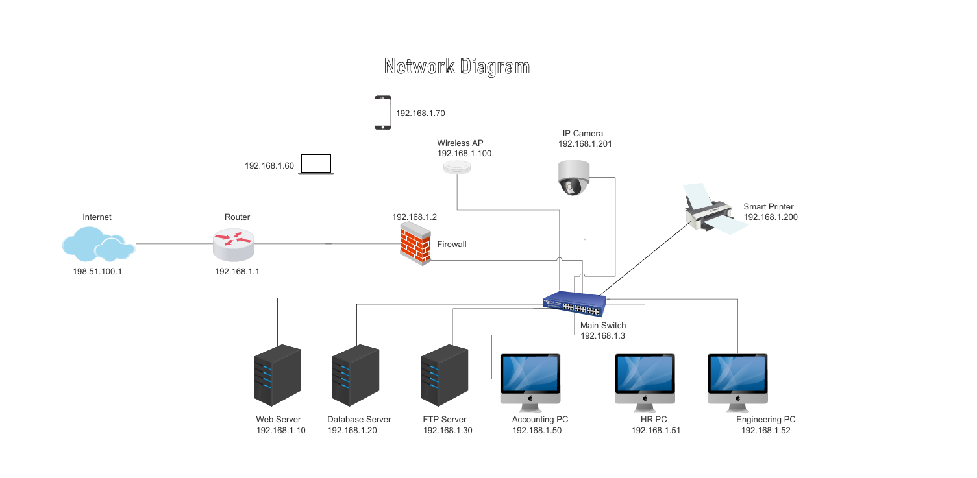

Current Network Diagram Overview
Components: internet → router (192.168.1.1) → single firewall → one switch (192.168.1.3)
Endpoints: web server; database; FTP server; 3 user PCs; wireless AP; mobile device; smart printer; IP camera
Key Issue
one /24 subnet exposes the entire network

Slide 7
Vulnerability Analysis

Slide 8




Vulnerability Analysis
Vulnerability
Why it matters
Flat network (no VLANs)
One /24 means lateral movement is trivial; a compromised printer can reach the database
No DMZ
Web/FTP servers sit beside internal systems; an exposed CVE pivots straight to PII/IP
Single firewall, no HA
Single point of failure; one outage takes the perimeter offline
Unencrypted FTP (port 21)
Credentials and files in clear text; trivially sniffed
No IDS/IPS
Attacker traffic (exploits, C2 beacons) goes unnoticed
No MFA / weak auth
Credential theft → full account takeover; especially risky for finance/HR/engineering
Default credentials on IoT (camera, printer)
Botnet recruitment + lateral pivot into the LAN
No centralized logging / monitoring
Incidents detected late or not at all; no audit trail for compliance
Any one of these is exploitable on its own; together they form a chain that lets a single phishing email reach the crown-jewel CAD repository in hours.

Slide 9
Prioritize RISK

Slide 10













Risk Prioritization
Risk
Likelihood
Impact
Severity
Flat network → lateral movement
High
High
Critical
Public-facing services on internal LAN
High
High
Critical
Unencrypted FTP credentials
High
High
Critical
No MFA on privileged accounts
High
High
Critical
Single firewall (no HA)
Medium
High
High
No IDS/IPS visibility
Medium
High
High
Default IoT credentials
Medium
Medium
High
No centralized logging
Medium
Medium
Medium
Justification: prioritization reflects aerospace IP value, ITAR exposure, and realistic threat-actor TTPs.

Slide 11
Network Redesign

Slide 12
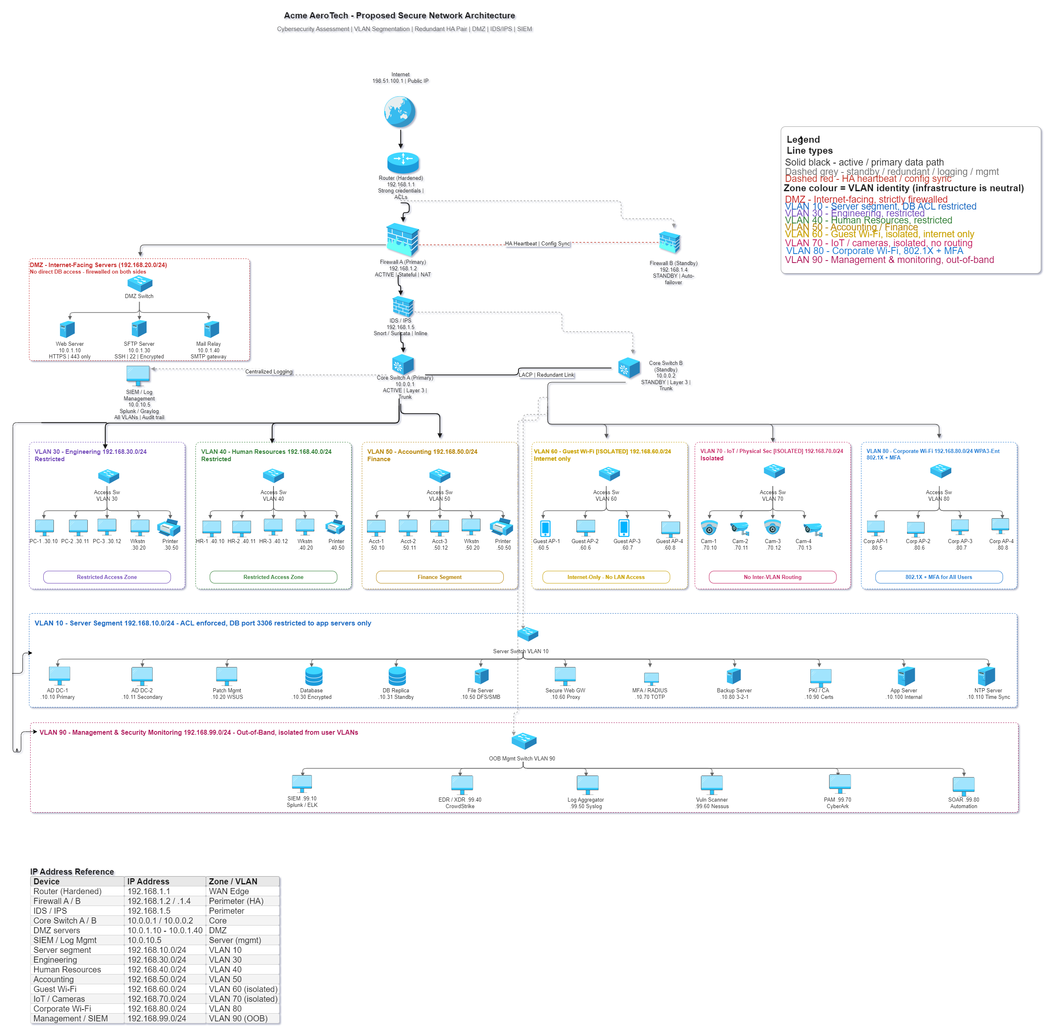
Recommend Network Redesign
Segmentation & Perimeter
VLAN segmentation across 8 zones; default-deny ACL between VLANs
DMZ for internet-facing services; web/SFTP/mail isolated
Firewall HA pair with auto-failover; redundant Layer-3 core switches with LACP
Monitoring & Access
Inline IDS/IPS (Snort/Suricata) between firewall and core
Protocol upgrades: FTP→SFTP; HTTP→HTTPS; SMTP gateway behind firewall
Access controls: 802.1X + NAC; WPA3-Enterprise; guest isolated; IoT VLAN with no inter-VLAN routing
Data & Protection
OOB management VLAN 90: bastion host; SIEM; EDR; PAM; SOAR
Data protection: MFA/RADIUS; internal PKI/CA; encrypted DB + standby replica; 3-2-1 backups

Slide 13
Security Controls

Slide 14
Proposed Security Controls
Control
Mitigates
VLAN segmentation + ACLs
Flat network, lateral movement
DMZ with separate firewall rules
Public-facing services on internal LAN
Firewall HA pair + redundant core
Single point of failure
Inline IDS/IPS
No threat visibility / late detection
SFTP (replaces FTP); HTTPS only
Cleartext credentials and data
MFA + RADIUS + internal PKI
Credential theft, weak auth
802.1X NAC at access layer
Unauthorized device on the LAN
WPA3-Enterprise + isolated Guest/IoT VLANs
Rogue/insecure wireless + default IoT creds
Centralized SIEM, EDR/XDR, syslog, SOAR
No monitoring / no audit trail
Encrypted DB + 3-2-1 backups + DB replica
Data loss, ransomware recovery
Out-of-band management VLAN + bastion + PAM
Lateral movement to management plane
Patch management (WSUS) + vuln scanner (Nessus)
Unpatched systems

Slide 15
Tradeoff Analysis

Slide 16
Security Control Trade-off Analysis
Trade-offs
Phased rollout (90-day)
Cost
Days 1–14
HA firewalls, EDR, SIEM, PAM licensing + hardware
Firewall HA pair, IDS/IPS inline, replace FTP with SFTP, default-deny baseline ACL
Complexity
VLAN ACLs and 802.1X need tuning; rule sprawl risk
Days 15–45
VLAN segmentation, NAC/802.1X pilot on one floor, MFA for privileged + remote accounts
User impact
MFA adds friction; guest Wi-Fi captive portal step
Days 46–75
Dependencies
OOB management VLAN, SIEM + EDR rollout, encrypted DB + replica, backup overhaul
PKI needs CA team; SIEM needs log forwarding
Days 76–90
WPA3-Ent migration, IoT VLAN cutover, PAM onboarding, SOAR playbooks, tabletop test

Slide 17
Key Takeaways

Slide 18

Lessons Learned Key Takeaways
Segmentation is highest leverage
reduce blast radius
Diagrams forced clarity
exposed hidden assumptions
Segmentation is the single highest-leverage control — most network problems are really blast-radius problems.
Defense in depth matters
redundancy buys response time
Visibility enables containment
SIEM/EDR/logs matter
Start with asset list
controls follow value

Slide 19
Questions

Slide 20



Questions or Closing Thoughts
Acme AeroTech — Secure Network Redesign
Happy to discuss any part of the design — vulnerabilities, controls, or rollout sequencing.
Thank You

